Slide 1

Network Protocols

Slide 2
Objectives
After completing this chapter, you will be able to:
▪ Explain how rules are used to facilitate communication.
▪ Explain the role of protocols and standards organizations in
facilitating interoperability in network communications.
▪ Explain how devices on a LAN access resources in a small to
medium-sized business network.

Slide 3
Rules of Communication
Network Protocols and Standards
Moving Data in the Network
Summary

Slide 4
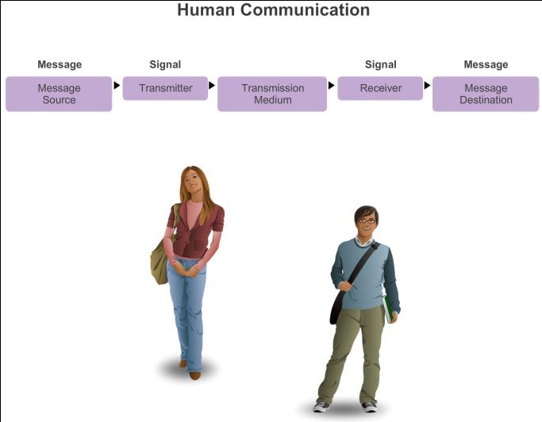
The Rules
What is Communication?

Slide 5
The Rules
Establishing the Rules
▪ An identified sender and receiver
▪ Agreed upon method of communicating (face-to-face, telephone, letter,
photograph)
▪ Common language and grammar
▪ Speed and timing of delivery
▪ Confirmation or acknowledgment requirements

Slide 6
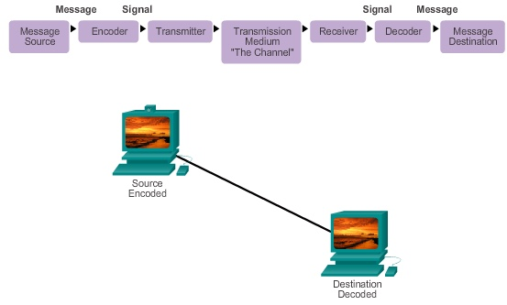
The Rules
Message Encoding

Slide 7

The Rules
Message Formatting and Encapsulation
Example: Personal letter contains the following elements:
▪ Identifier of the recipient’s location
▪ Identifier of the sender’s location
▪ Salutation or greeting
▪ Recipient identifier
▪ The message content
▪ Source identifier
▪ End of message indicator

Slide 8
The Rules
Message Size
An overview of the segmenting process:
▪ The size restrictions of frames require the source host to break a long
message into individual pieces (or segments) that meet both the minimum
and maximum size requirements.
▪ Each segment is encapsulated in a separate frame with the address
information, and is sent over the network.
▪ At the receiving host, the messages are de-encapsulated and put back
together to be processed and interpreted.

Slide 9
The Rules
Message Timing
▪ Access Method
▪ Flow Control
▪ Response Timeout

Slide 10
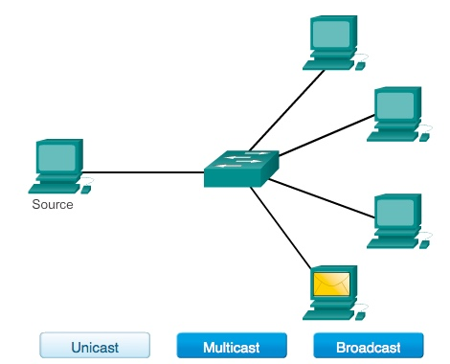
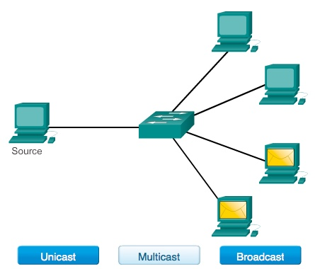
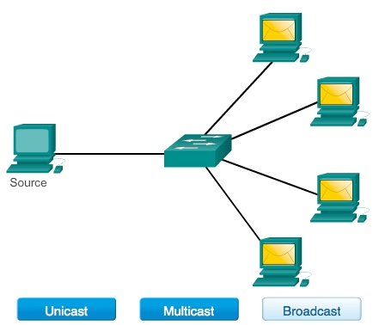
The Rules
Message Delivery Options

Slide 11
Network Protocols and Standards

Slide 12
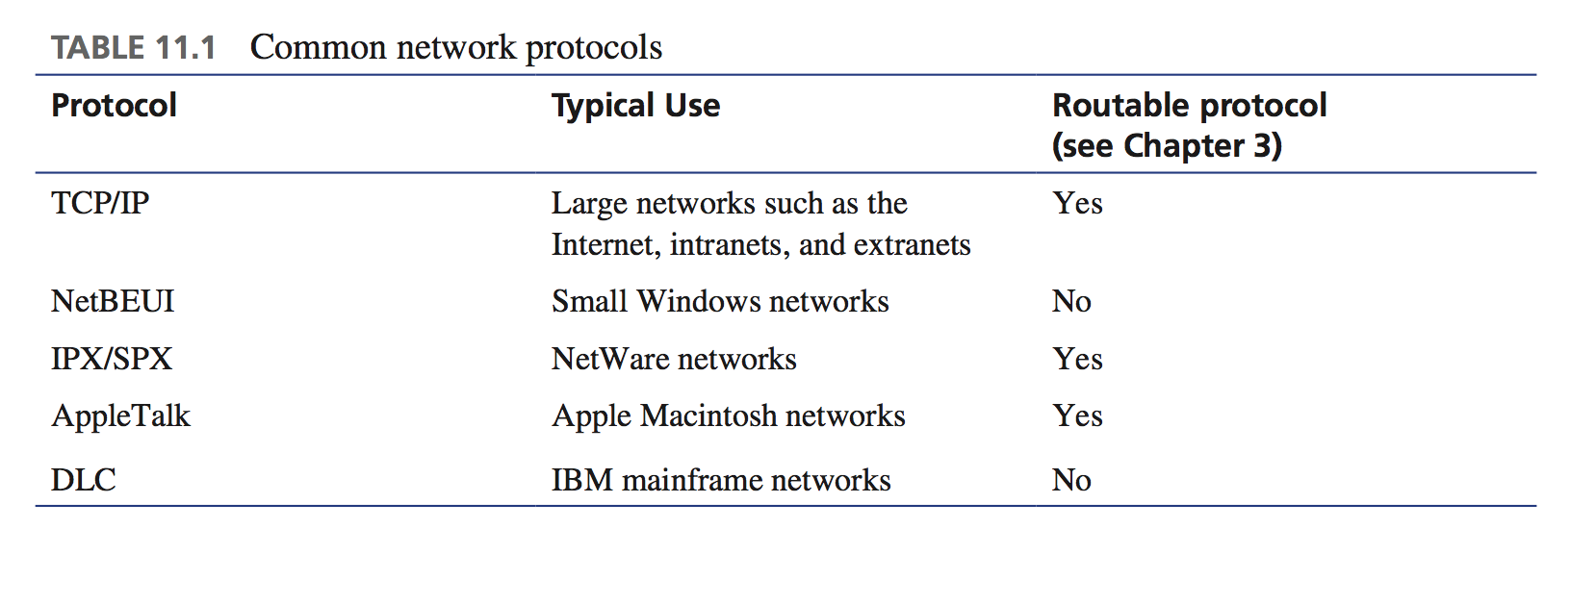

Slide 13
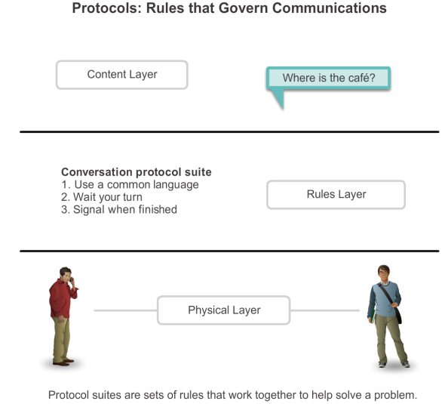
Protocols
Rules that Govern Communications

Slide 14
Protocols
Network Protocols
▪ How the message is formatted or structured
▪ The process by which networking devices share information about
pathways with other networks
▪ How and when error and system messages are passed between devices
▪ The setup and termination of data transfer sessions

Slide 15
Protocols
Interaction of Protocols
▪ Application Protocol – Hypertext Transfer Protocol (HTTP)
▪ Transport Protocol – Transmission Control Protocol (TCP)
▪ Internet Protocol – Internet Protocol (IP)
▪ Network Access Protocols – Data link & physical layers

Slide 16
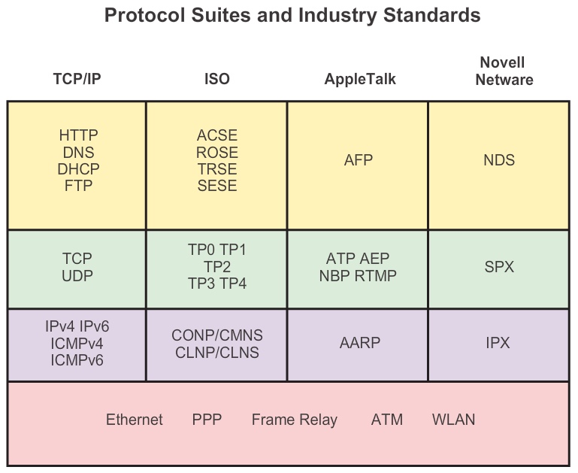
Protocol Suites
Protocol Suites and Industry Standards

Slide 17
Protocol Suites
Creation of Internet, Development of TCP/IP
▪ The first packet switching network and predecessor to today’s Internet
was the Advanced Research Projects Agency Network (ARPANET),
which came to life in 1969 by connecting mainframe computers at four
locations.
▪ ARPANET was funded by the U.S. Department of Defense for use by
universities and research laboratories. Bolt, Beranek and Newman (BBN)
was the contractor that did much of the initial development of the
ARPANET, including creating the first router known as an Interface
Message Processor (IMP).

Slide 18
▪ In 1973, Robert Kahn and Vinton Cerf began work on TCP to develop the
next generation of the ARPANET. TCP was designed to replace
ARPANET’s current Network Control Program (NCP).
▪ In 1978, TCP was divided into two protocols: TCP and IP. Later, other
protocols were added to the TCP/IP suite of protocols including Telnet,
FTP, DNS, and many others.

Slide 19
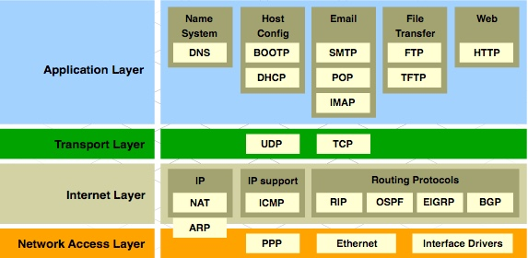
Protocol Suites
TCP/IP Protocol Suite and Communication

Slide 20







Standards Organizations
Open Standards
▪ The Internet Society (ISOC)
▪ The Internet Architecture Board (IAB)
▪ The Internet Engineering Task Force (IETF)
▪ Institute of Electrical and Electronics Engineers (IEEE)
▪ The International Organization for Standards (ISO)

Slide 21

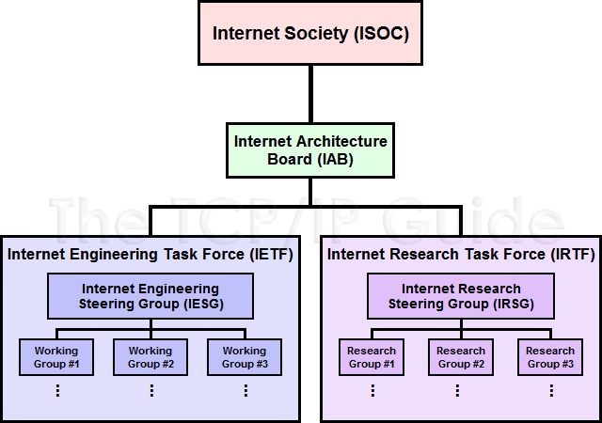



Standards Organizations
ISOC, IAB, and IETF

Slide 22
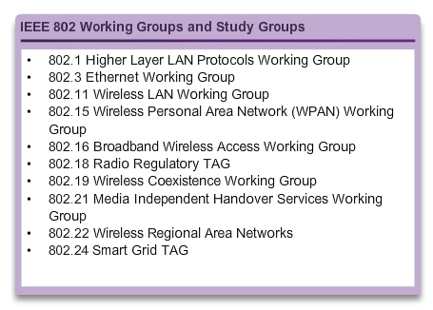
Standards Organizations
IEEE
▪ 38 societies
▪ 130 journals
▪ 1,300 conferences each year
▪ 1,300 standards and projects
▪ 400,000 members
▪ 160 countries
▪ IEEE 802.3
▪ IEEE 802.11

Slide 23

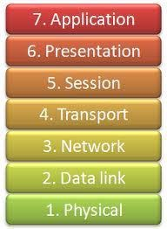
Standards Organizations
ISO
OSI Model

Slide 24
Standards Organizations
Other Standards Organization
▪ The Electronic Industries Alliance (EIA)
▪ The Telecommunications Industry Association (TIA)
▪ The International Telecommunications Union – Telecommunications
Standardization Sector (ITU-T)
▪ The Internet Corporation for Assigned Names and Numbers (ICANN)
▪ The Internet Assigned Numbers Authority (IANA)

Slide 25
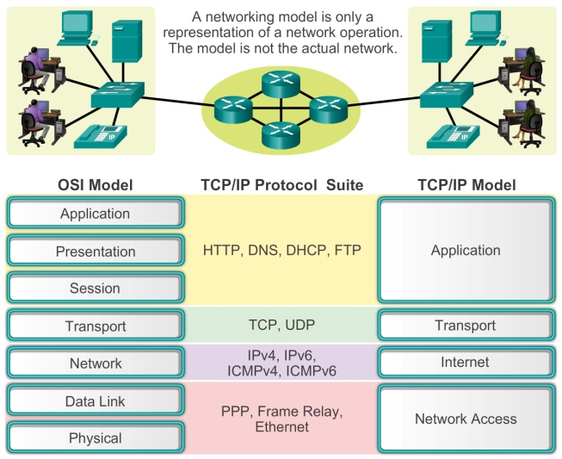
Reference Models
Benefits of Using a Layered Model

Slide 26
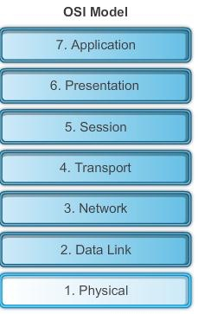
Reference Models
The OSI Reference Model

Slide 27
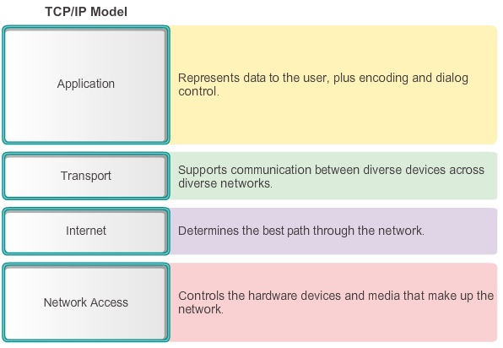
Reference Models
The TCP/IP Reference Model

Slide 28
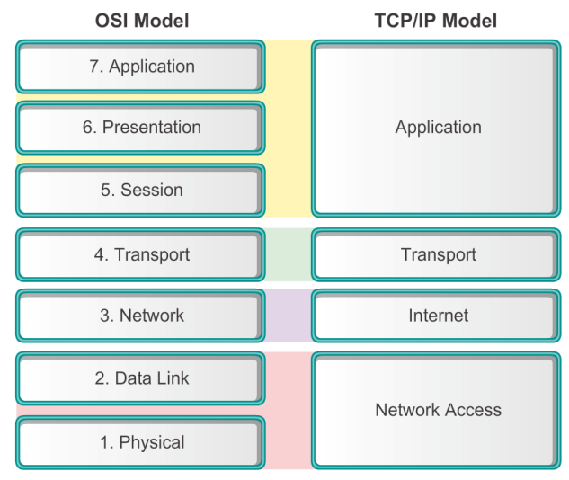
Reference Models
Comparing the OSI and TCP/IP Models

Slide 29
Moving Data in the Network

Slide 30
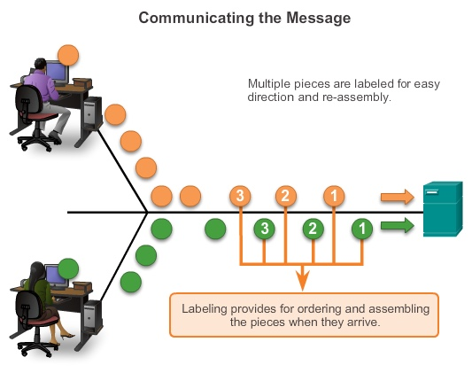
Data Encapsulation
Communicating the Messages
▪ Segmenting message benefits
Different conversations can be interleaved
Increased reliability of network communications
▪ Segmenting message disadvantage
Increased level of complexity

Slide 31
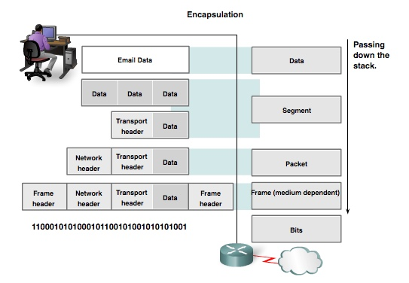
Data Encapsulation
Protocol Data Units (PDUs)
▪ Data
▪ Segment
▪ Packet
▪ Frame
▪ Bits

Slide 32
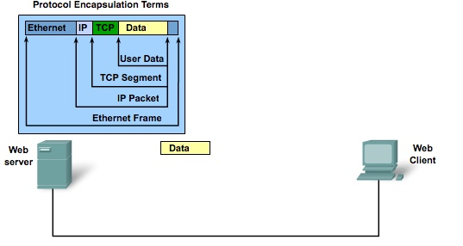
Data Encapsulation
Protocol Encapsulation

Slide 33
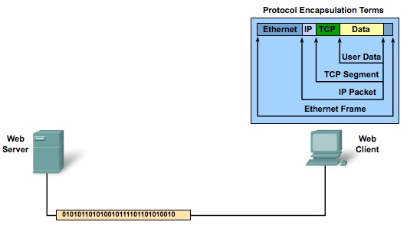
Data Encapsulation
Protocol De-encapsulation

Slide 34
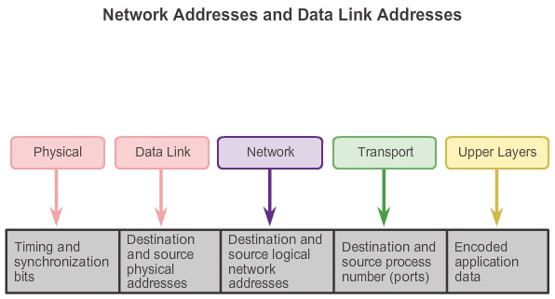
Moving Data in the Network
Accessing Local Resources

Slide 35
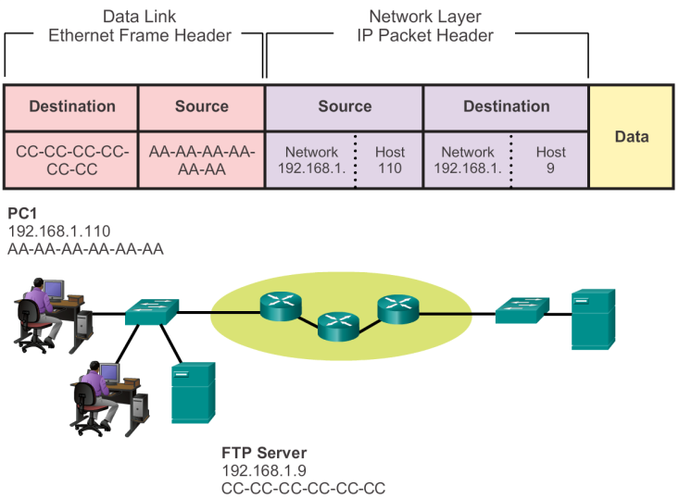

Accessing Local Resources
Communicating with Device / Same Network

Slide 36




Accessing Local Resources
MAC and IP Addresses
R1
192.168.1.1
11-11-11-11-11-11
ARP
Request
S1 R1
PC1
192.168.1.110
AA-AA-AA-AA-AA-AA
PC2
192.168.1.111
BB-BB-BB-BB-BB-BB
FTP Server
192.168.1.9
CC-CC-CC-CC-CC-CC

Slide 37
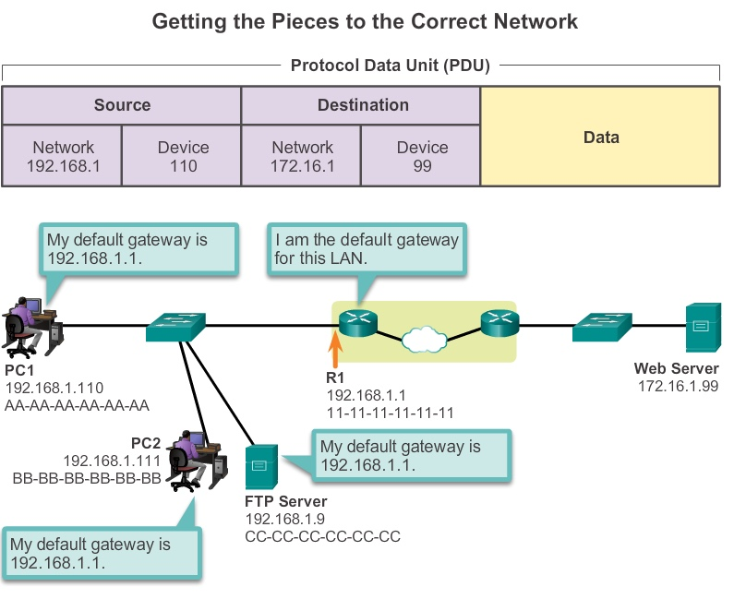
Accessing Remote Resources
Default Gateway

Slide 38
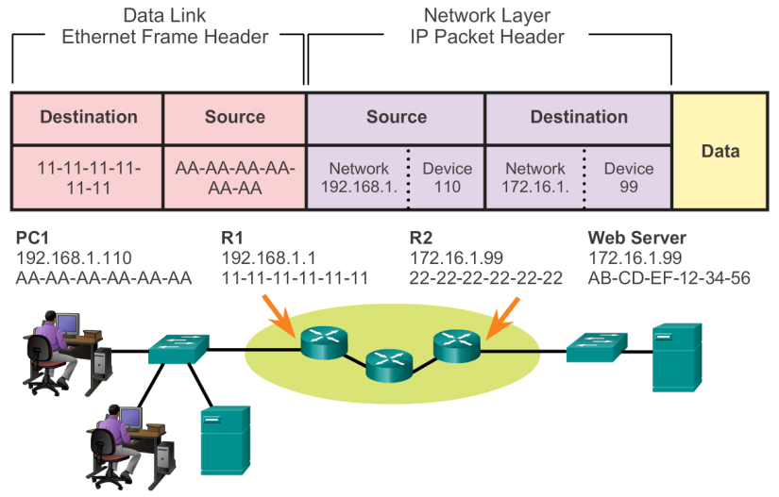
Accessing Remote Resources
Communicating Device / Remote Network

Slide 39
Network Protocols and Communications
Summary
In this chapter, you learned:
▪ Data networks are systems of end devices, intermediary devices, and the
media connecting the devices. For communication to occur, these devices
must know how to communicate.
▪ These devices must comply with communication rules and protocols.
TCP/IP is an example of a protocol suite.

Slide 40
▪ Most protocols are created by a standards organization such as the IETF
or IEEE.
▪ The most widely-used networking models are the OSI and TCP/IP
models.
▪ Data that passes down the stack of the OSI model is segmented into
pieces and encapsulated with addresses and other labels. The process is
reversed as the pieces are de-encapsulated and passed up the
destination protocol stack.

Slide 41
Network Protocols and Communications
Summary (cont.)
In this chapter, you learned:
▪ The OSI model describes the processes of encoding, formatting,
segmenting, and encapsulating data for transmission over the network.
▪ The TCP/IP protocol suite is an open standard protocol that has been
endorsed by the networking industry and ratified, or approved, by a
standards organization.

Slide 42
▪ The Internet Protocol Suite is a suite of protocols required for transmitting
and receiving information using the Internet.
▪ Protocol Data Units (PDUs) are named according to the protocols of the
TCP/IP suite: data, segment, packet, frame, and bits.
▪ Applying models allows individuals, companies, and trade associations to
analyze current networks and plan the networks of the future.

